Slide 1
IGNITING THE SPARK!
DECLARING WHAT MAKES YOU A 'MUST-HAVE'

Slide 2
IGNITING THE SPARK!
DECLARING WHAT MAKES YOU A 'MUST-HAVE'
In this lesson, you’re going to learn how to masterfully craft the message you communicate to your ideal client.
This structure will give you the power to build instant connection, authority and trust with your dream client every time, whether you’re speaking to a large group of people or just one.
This structure will allow you to attract early interest in your offer and get your dream client ready, eager, and even asking to work with you!

Slide 3
IGNITING THE SPARK!
DECLARING WHAT MAKES YOU A 'MUST-HAVE'
In Week One, you learned all about your dream client’s excruciating torture and absolute bliss. Now, we’re going to discover exactly how to become a MUST-HAVE for that ideal client.
In the Bliss, you wrote down an exhaustive list of all the amazing outcomes they will experience when they get there. The specific, tangible differences in their life. Now, we’re going to take it further by inserting your unique program into the equation.

Slide 4
IGNITING THE SPARK!
DECLARING WHAT MAKES YOU A 'MUST-HAVE'
You’re going to list all the amazing benefits your clients will receive while experiencing this program. Name this list your “Program Benefits List”. It will serve as a very important tool going forward as you communicate your program’s unique value.
PAUSE this lesson for 7 minutes and write an exhaustive list of all your program benefits. Just keep writing for 7 minutes straight until you can’t think of another thing.

Slide 5
IGNITING THE SPARK!
DECLARING WHAT MAKES YOU A 'MUST-HAVE'
Remember the Torture from week one? You painted a pretty grim picture of how terrible their life is right now. They know this. They live it every day. Calling it out will absolutely get their attention. What will pull them in further, is telling them why they won’t do it.
Excuses are defense mechanisms that make us feel safe and rational, when we are unwilling to fix something in our lives that’s broken.

Slide 6
IGNITING THE SPARK!
DECLARING WHAT MAKES YOU A 'MUST-HAVE'
Right now, you’re going to make a list of all the things your dream client DREADS doing or is INSECURE about doing, that they believe they’ll NEED to do, to solve their problem. These are the things that are stopping them from getting help. The reasons why they think they can’t achieve their dream.
Name this your, “Excuse-Solution Table”

Slide 7
IGNITING THE SPARK!
DECLARING WHAT MAKES YOU A 'MUST-HAVE'
Pause this video for 7 minutes, and write an exhaustive list of those fears and insecurities. Keep writing until you have exhausted every single insecurity and limiting belief that your dream client may be feeling or thinking. Just keep going until you can’t think of another single thing. Total brain dump.
Then, point-for-point, list how your program solves each one of them. Make two columns In the first column, list each fear and insecurity, line by line. In the second column, list its corresponding solution via your program.

Slide 8
IGNITING THE SPARK!
DECLARING WHAT MAKES YOU A 'MUST-HAVE'
This will be a LIVING document for you that you will revisit and revise often. OK, set your timer for 7 minutes, pause this video and… GO.

Slide 9
IGNITING THE SPARK!
DECLARING WHAT MAKES YOU A 'MUST-HAVE'
List all FALSE BELIEFS that are being perpetuated by other experts or people they may be following for advice. The myths you believe are KILLING their chances of success or forcing them down a path of delayed relief. These are likely the very beliefs fueling your dream client’s fears and insecurities.

Slide 10
IGNITING THE SPARK!
DECLARING WHAT MAKES YOU A 'MUST-HAVE'
List all FALSE BELIEFS that are being perpetuated by other experts or people they may be following for advice. The myths you believe are KILLING their chances of success or forcing them down a path of delayed relief. These are likely the very beliefs fueling your dream client’s fears and insecurities.
Pause this video again and make a list entitled “FALSE BELIEFS”. And fill that list with all the things you believe are stopping or slowing down your dream client’s success. See you in a bit!

Slide 11
THE 5 COMPONENTS
PUTTING IT ALL TOGETHER
The three activities that you just did: Your Program Benefits List, your Excuse Solution Table, and your list of False Beliefs contain the content that you will draw from when you structure your communications.
Every time you communicate to the marketplace, you’ll pick a couple of things from each list to structure your message. Using the following guidelines:

Slide 12
THE 5 COMPONENTS
PUTTING IT ALL TOGETHER
Pull something from the FALSE BELIEFS list.
Pull some powerful points from your TORTURE list.
Pull something from the Excuse column of the EXCUSE-SOLUTION list.
Pull something from your BLISS list.
Pull something from your PROGRAM BENEFITS list.

Slide 13
IGNITING THE SPARK!
DECLARING WHAT MAKES YOU A 'MUST-HAVE'

Slide 14
IGNITING THE SPARK!

Slide 15
IGNITING THE SPARK!

Slide 16
DIGGING INTO THE PAIN

Slide 17
DIGGING INTO THE PAIN

Slide 18
PUTTING IT ALL TOGETHER
"If you can't sell ... you're never going to have a successful business." (False Belief)
At least according to some business gurus. Everyday I speak to discouraged, hard-working, underpaid coaches, consultants and service providers who believe this. (Torture. We SEE them)
They're not natural salespeople, and so they believe they're always going to be fighting for clients, low-balling their rates, and will never build a successful, thriving business. (Insecurities, fears)
But that's EXACTLY why I set up 'Become a MUST-HAVE for your DREAM Clients' (solution)
This new, free Facebook group is specifically for coaches, consultants and service providers who want to thrive, but HATE selling. (Bliss, while acknowledging the Insecurities, fears)
We discuss how ANY business owner can have all the success they ever want, without all the uncomfortable 'sales-y' stuff that feels weird and unnatural. They become a MUST-HAVE for their ideal clients, time after time, and stand out from their competition without needing a single sales conversation. Even if no one has ever heard of them before. (Solution: The Bliss without the pain)
We have live Q&As, support, and expert insights into just what it takes to create an in-demand, high-value business or service, without needing to be a master of marketing. (Program Bliss List/ Bliss without pain).

Slide 19
BE THE LOGICAL CHOICE

Slide 20
BUILD TRUST

Slide 21
BUILD TRUST

Slide 22
BUILD TRUST

Slide 23
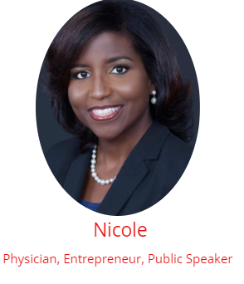
CASE STUDY
Jane Doe is a busy Physician, wife and mother. TIME was a huge concern.
Finding time to create the business she was so passionate about seemed almost impossible. She knew she needed help.
I worked with Jane to smash through her excuse-addiction, take accountable action and create CRAVE in her business.

Slide 24
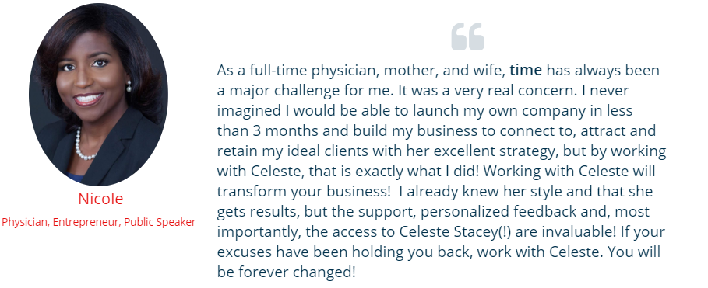
Jane’s Story
Shifted her mindset, created her dream business and is now in demand nationwide!
“Time has always been a major issue for me… This will transform your business!”

Slide 25
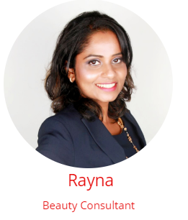
CASE STUDY
Jane Doe #2 is in the Beauty Industry
Stuck and discouraged by doing things the OLD WAY (blogging, YouTube, asking for ‘likes’, chasing leads, etc.) and not seeing results in her business
I worked with JD2 to shift her mindset and approach, and build CRAVE into her business.

Slide 26
JD2’s Story
Changed her approach and skyrocketed her income!
“I booked more new business in the past three months than in the past two years!

Slide 27
CREATE YOUR MUST-HAVE AD!
USE YOUR 5 COMPONENTS TO ATTRACT YOUR DREAM CLIENT

Slide 28
LET'S GO!
ACTION ITEM:
SUBMIT YOUR AD TO YOUR
COPY COACH FOR REVIEW!

Slide 29
PRE-FILTER
DECLARING WHAT MAKES YOU A 'MUST-HAVE'
cc: Marc Babin - https://unsplash.com/@westingrandcayman?utm_source=haikudeck&utm_medium=referral&utm_campaign=api-credit

Slide 30
PRE-FILTER
DECLARING WHAT MAKES YOU A 'MUST-HAVE'
cc: Marc Babin - https://unsplash.com/@westingrandcayman?utm_source=haikudeck&utm_medium=referral&utm_campaign=api-credit

Slide 31
BE CONGRUENT
DECLARING WHAT MAKES YOU A 'MUST-HAVE'
cc: Steve Halama - https://unsplash.com/@steve3p_0?utm_source=haikudeck&utm_medium=referral&utm_campaign=api-credit

Slide 32
BE CONGRUENT
DECLARING WHAT MAKES YOU A 'MUST-HAVE'
cc: Steve Halama - https://unsplash.com/@steve3p_0?utm_source=haikudeck&utm_medium=referral&utm_campaign=api-credit

